Slide 1
Predictive Analysis of Student Performance
Using Pandas, NumPy, Seaborn, and Matplotlib
~Priscilla L Miller~
12/3/2024

Slide 2
Predictors of High-School Student Performance
Gender
Ethnicity
Grade Level
Course Department (e.g., Math, Social Sciences, Performing Arts)
Marks (A=5, B=4, C=3, D=2, F=1)
Elementary School (for 8th grade)

Slide 3
Data Set
21,873 redacted rows
Classes and letter grades from 2018-2022
Grade Level –Freshman to Senior classes
CSVs imported into SQL
Loaded into Google Colab for further cleaning, analysis, and model training

Slide 4
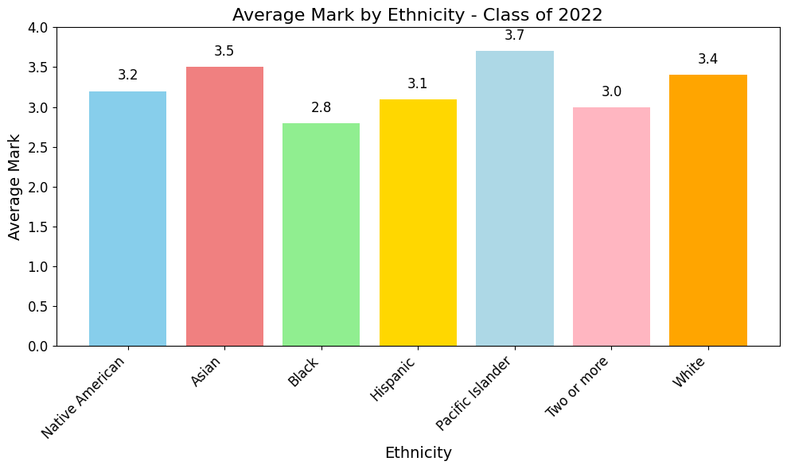
Title and Content Layout with Chart

Slide 5
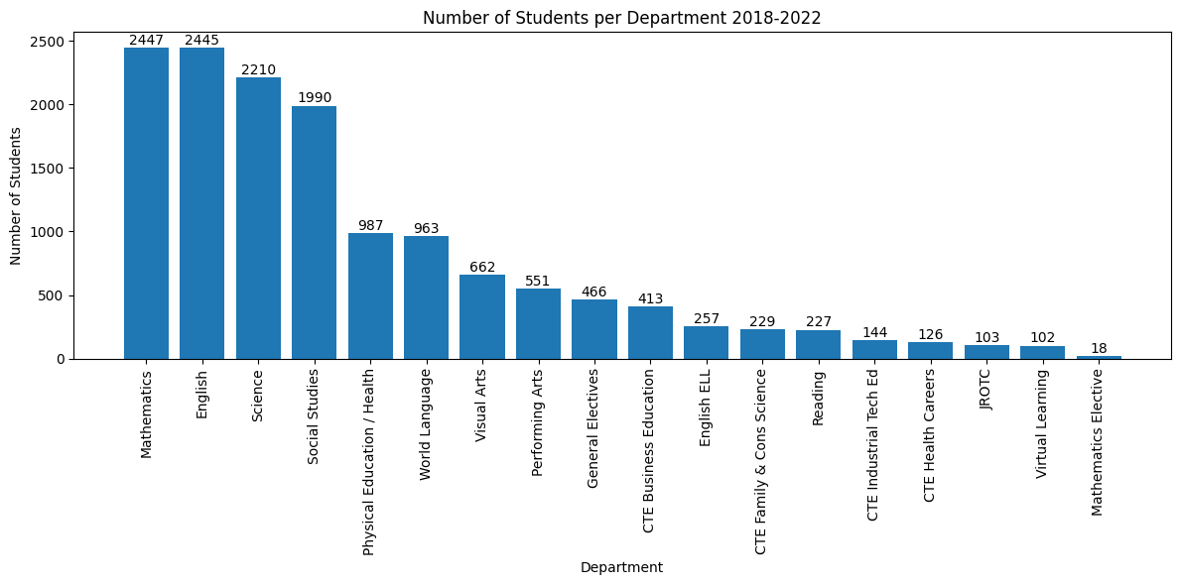
Title and Content Layout with Chart

Slide 6
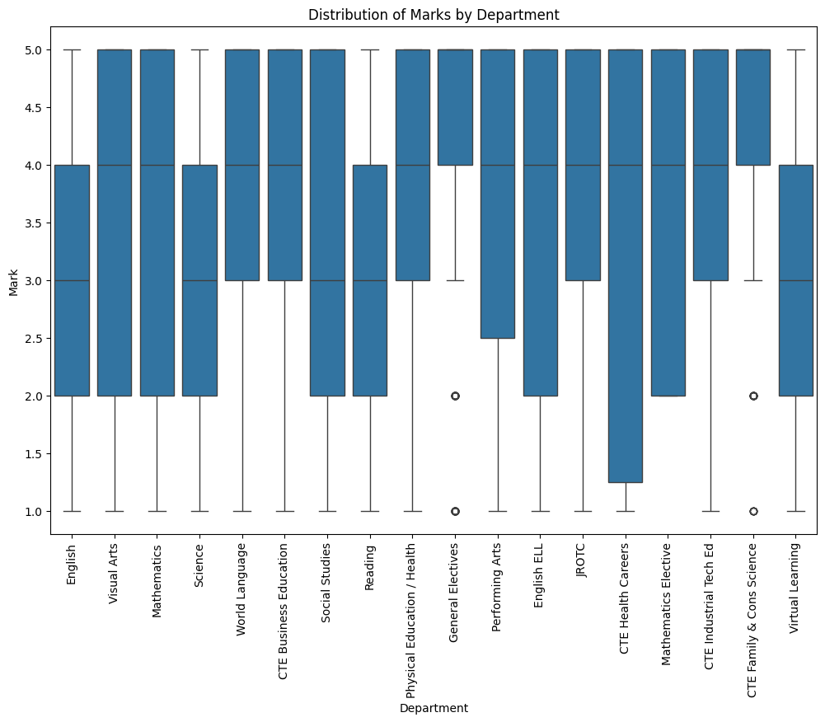
Title and Content Layout with Chart

Slide 7
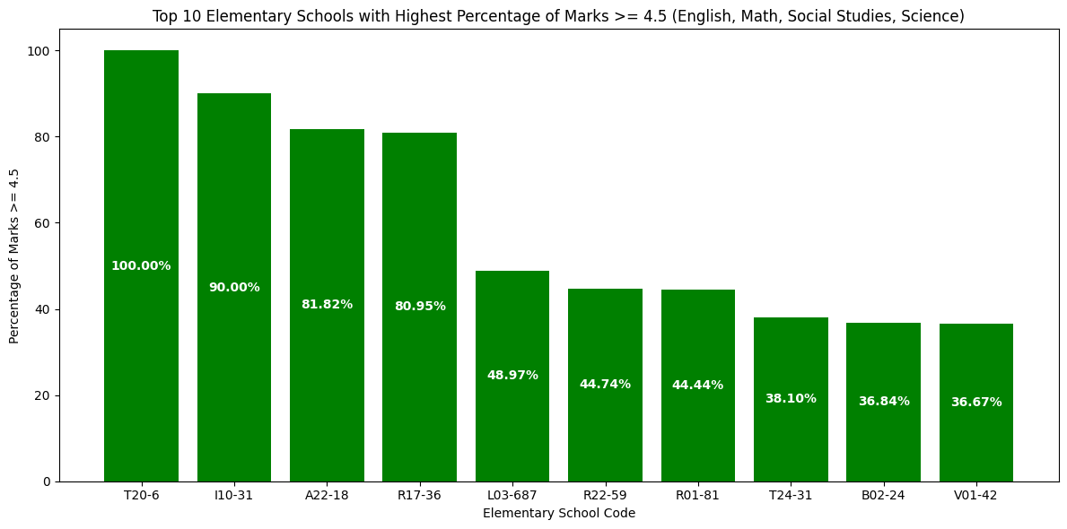
Title and Content Layout with Chart

Slide 8
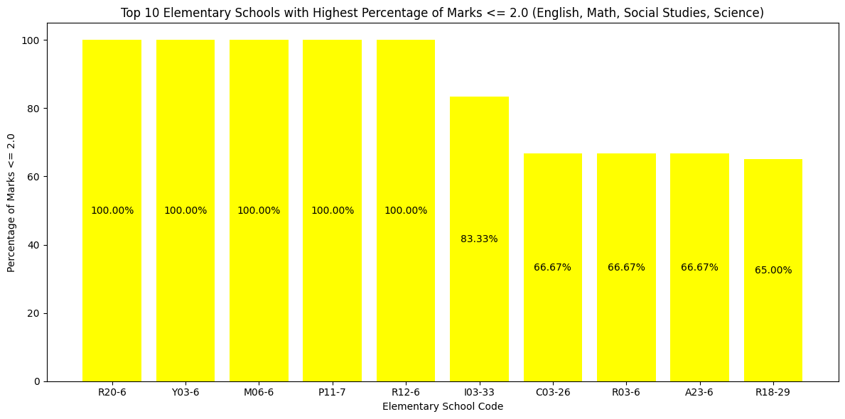
Title and Content Layout with Chart

Slide 9
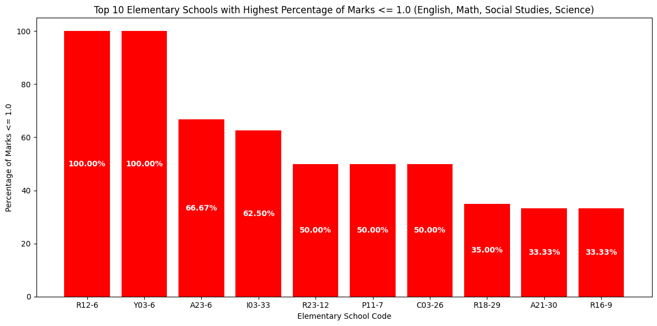
Title and Content Layout with Chart

Slide 10
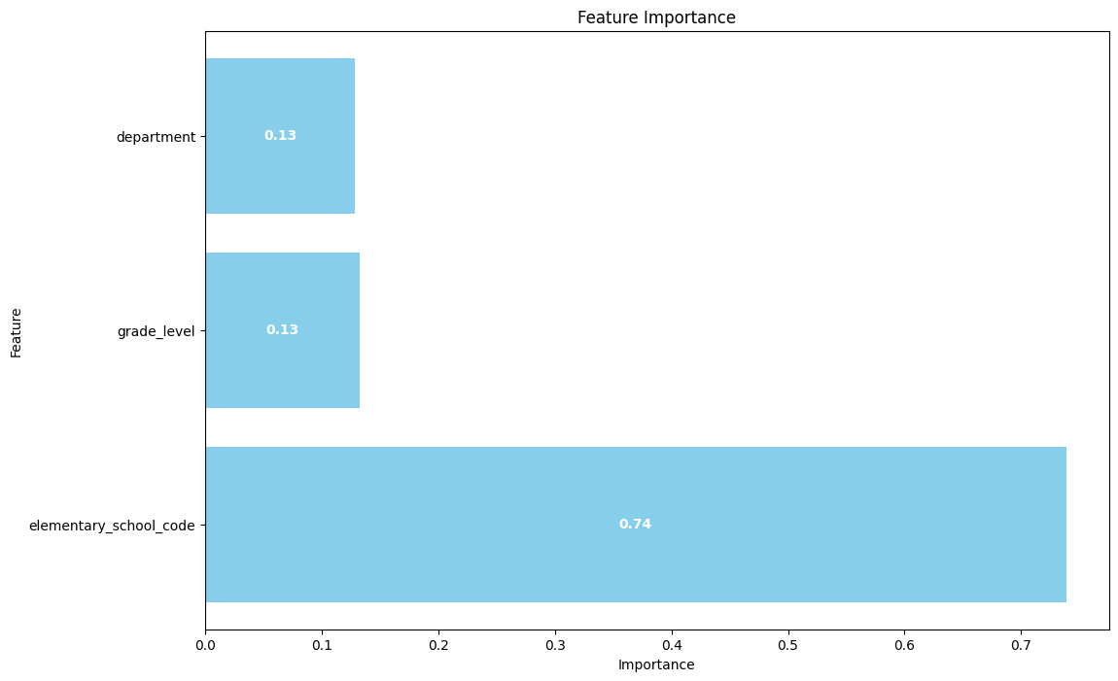
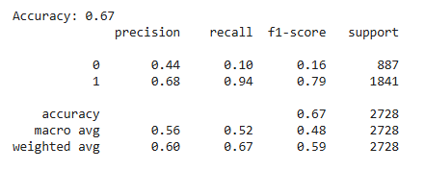
100 Trees
Class | Group 1 | Group 2
Class 1 | 82 | 95
Class 2 | 76 | 88
Class 3 | 84 | 90

Slide 11

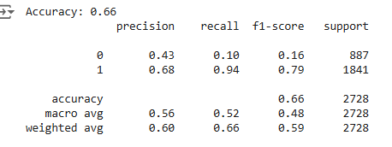
200 Trees
Class | Group 1 | Group 2
Class 1 | 82 | 95
Class 2 | 76 | 88
Class 3 | 84 | 90

Slide 12
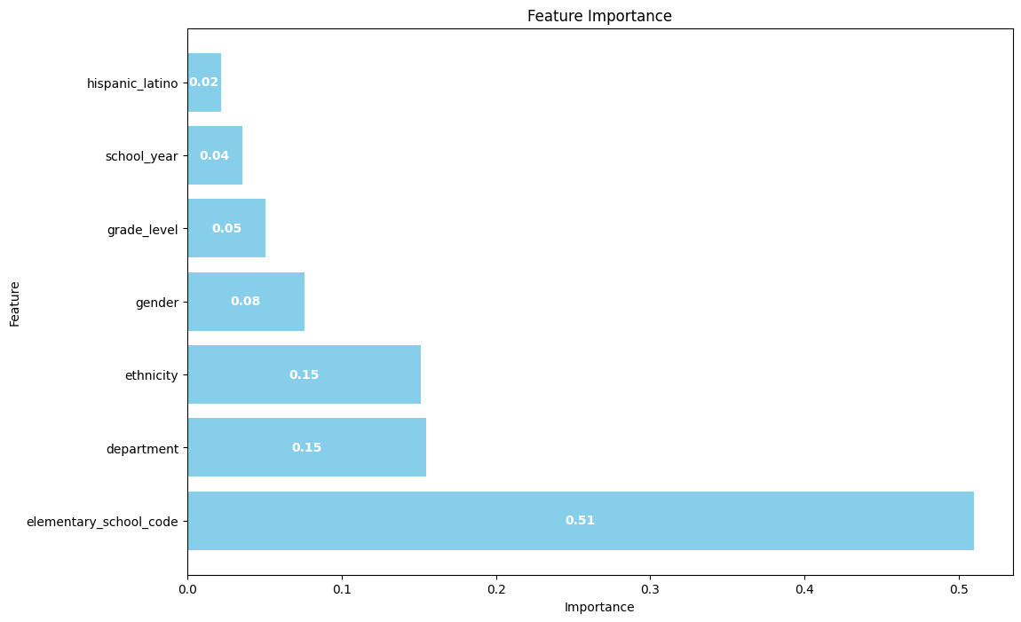
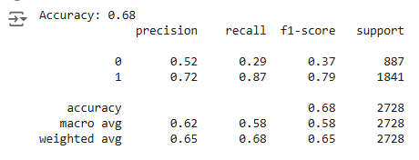
All Features
Class | Group 1 | Group 2
Class 1 | 82 | 95
Class 2 | 76 | 88
Class 3 | 84 | 90

Slide 13
Questions?

